Slide 1
Retail Transaction Analytics Platform
TECHNICAL ARCHITECTURE WALKTHROUGH
Scope: Ingestion, transformation, and interactive query serving for 1,067,371 multi-year retail transactions from the UCI Online Retail II dataset.

Slide 2
Problem Statement
High Volume Data Bottlenecks: Enterprise process millions of raw transactions daily, overwhelming traditional in-memory processing and causing system crashes.
Severe Data Quality Issues: Raw streams are filled with cancellations, unpriced line items and missing customer records that skew reporting.
Degraded Query Performance: Running Analytical aggregation directly on flat, unindexed transactional tables results in slow multi-second response times.
Solution
Lightweight Data Ingestion: A streamlined pipeline that processes data in controlled batches to prevent overload
Automated Data Cleansing: Standardize inputs, eliminates invalid entries and protect revenue metrics.
Dimensional Data modeling: Organizes data specifically to deliver instant dashboards and reports.
Role based Security & Governance: Enforces secure user access levels with complete admin oversight.

Slide 3
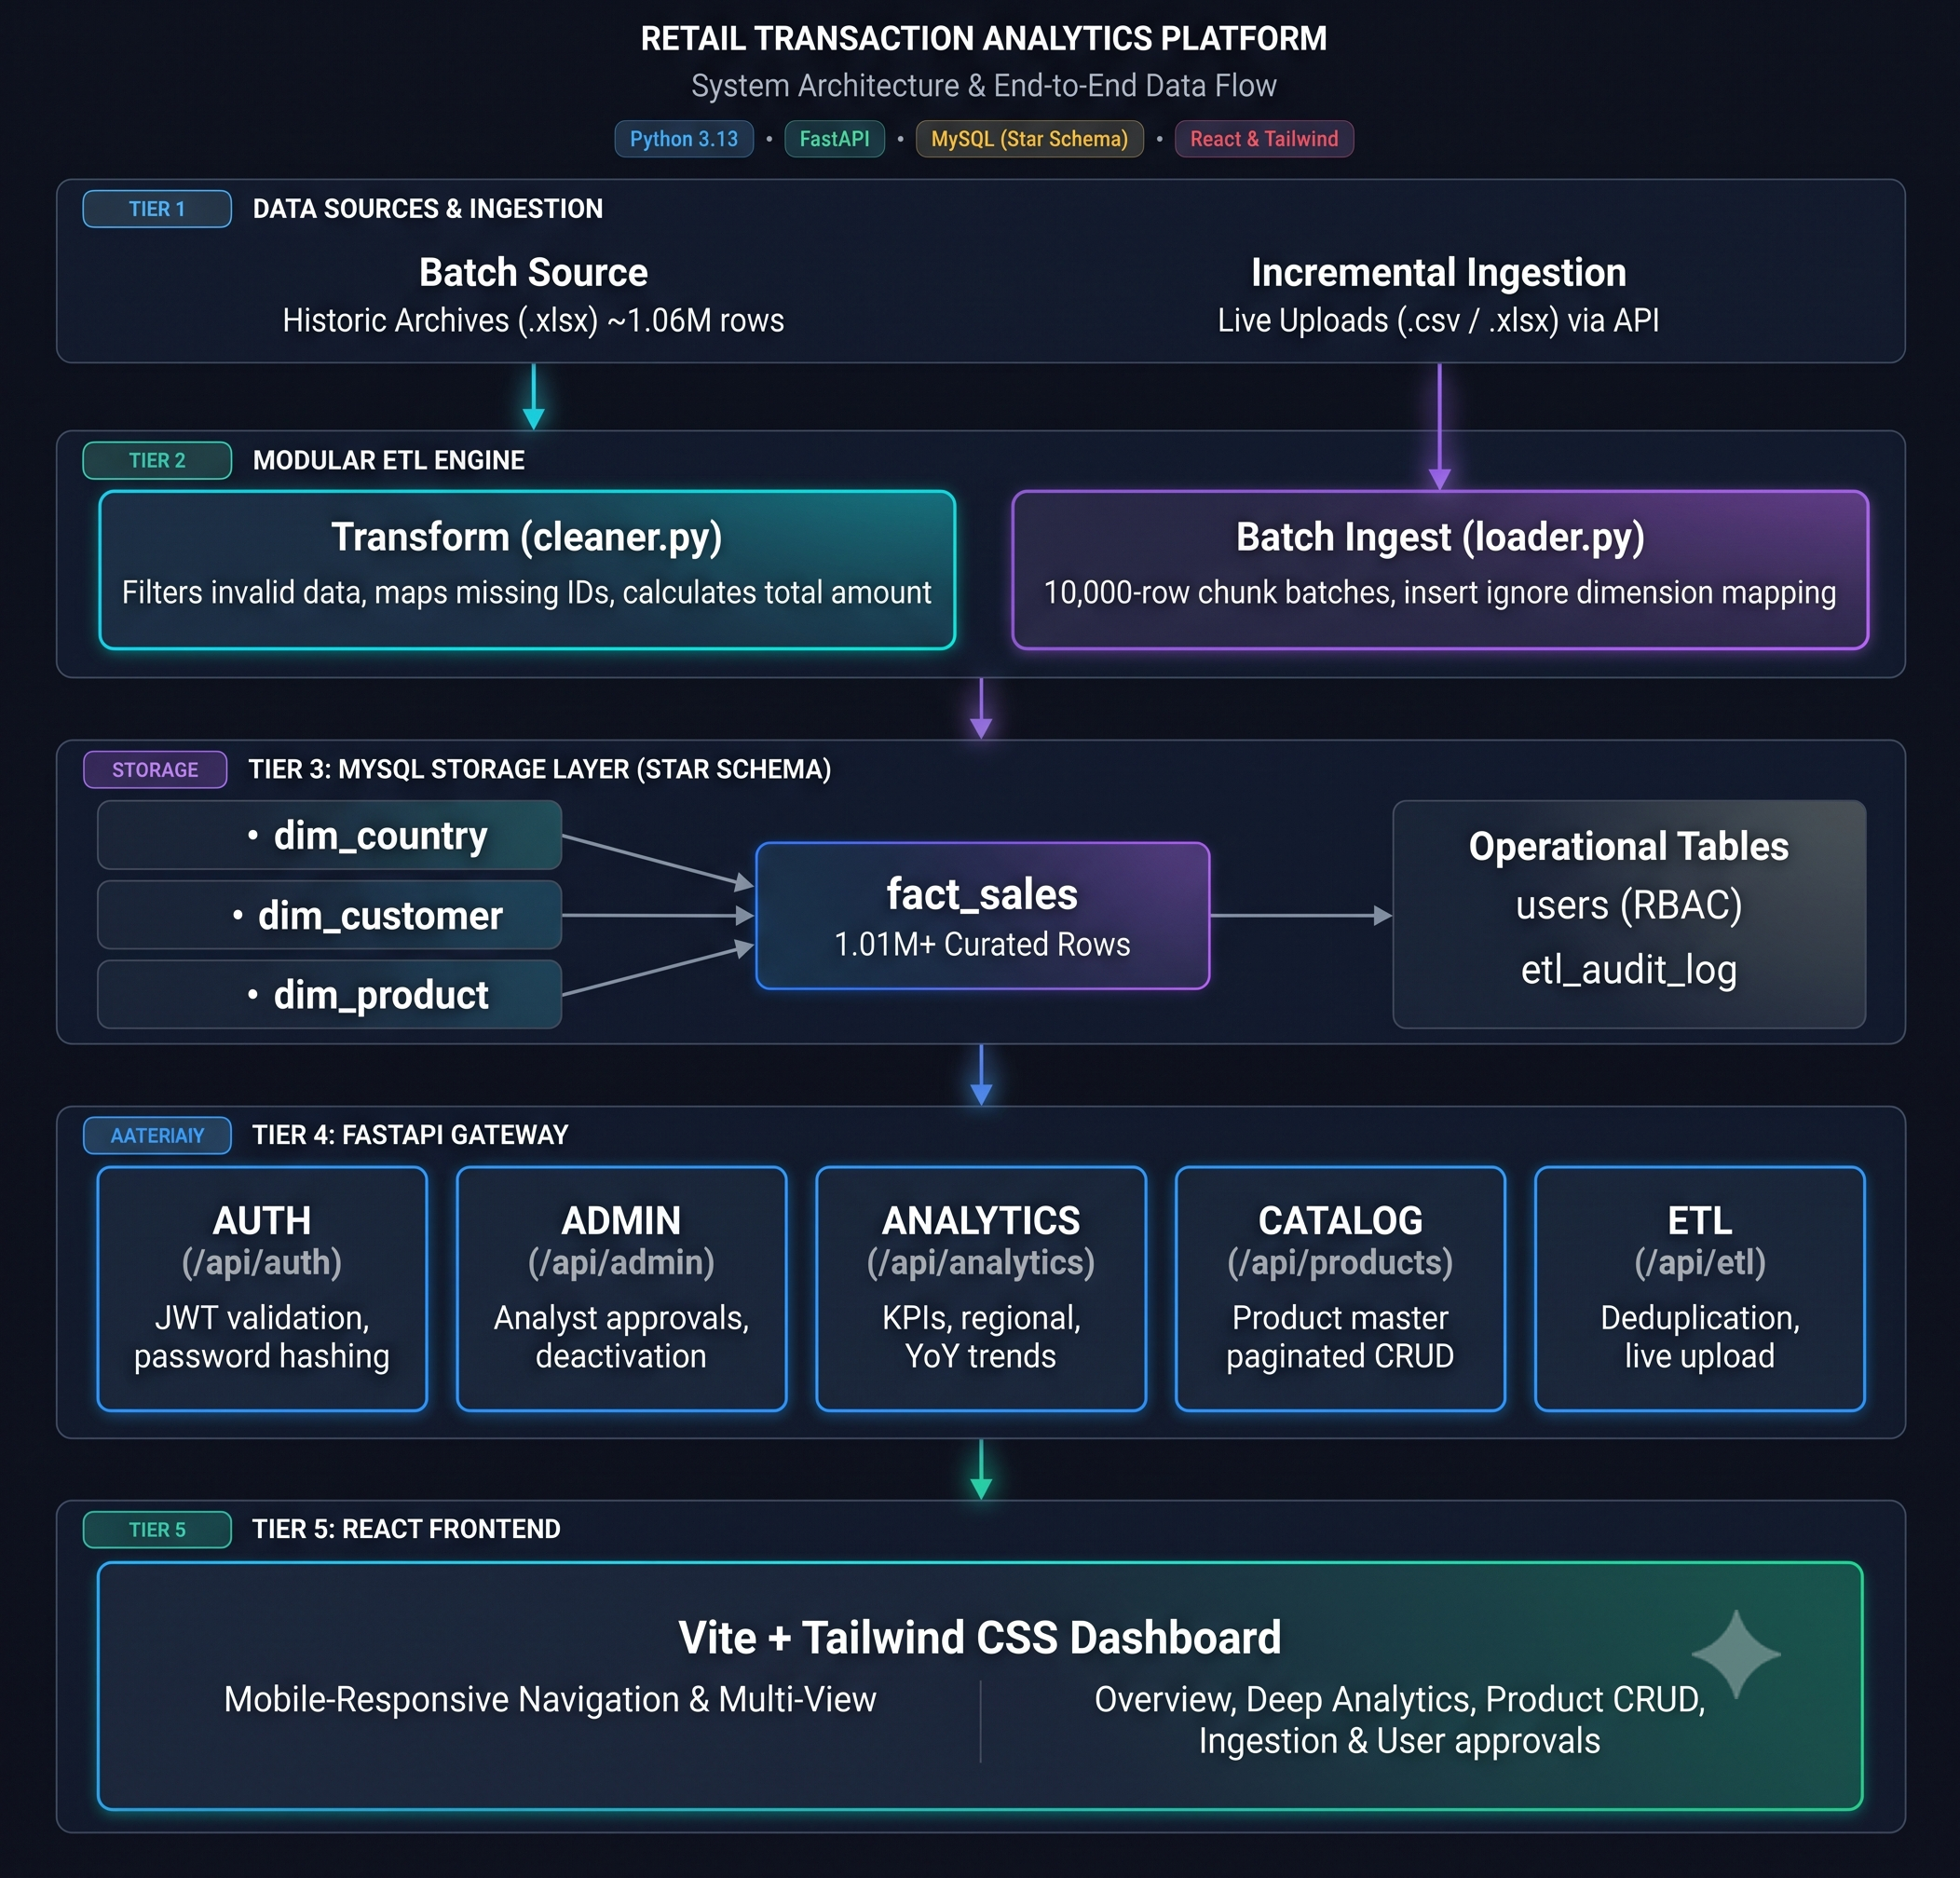
Architecture Diagram
Stage 1: Source: Excel archive (1.06M rows across 2 sheets).
Stage 2: ETL Pipeline: Streaming openpyxl parser with validation rules.
Stage 3: Database: MySQL normalized star schema with indexing.
Stage 4: Backend: FastAPI REST service with JWT-based authentication.
Stage 5: Frontend: React single-page application using Recharts.

Slide 4
ETL s Memory Management
DATA ENGINEERING
OUR IMPLEMENTATION
Read-only streaming iterator processing records in 10,000-row chunks.
In-memory caching for country and product dimension IDs to prevent redundant DB lookups.
THE PROBLEM
Standard pandas/DataFrame ingestion of
multi-sheet workbooks spikes memory beyond
1.5 GB, risking host crashes.
Outcome: Processed 1.06M rows with a peak RAM footprint under 130 MB.

Slide 5
Data Cleansing's Validation Rules
HYGIENE ENGINE
Rejection Criteria (Filtered out ~49k rows):
Cancellation orders: Invoices prefixed with 'C'.
Invalid transactions: Non-positive quantities (≤ 0) and zero or negative unit prices.
Corrupted records: Missing invoice identifiers or unparseable timestamps.
Preserved Volume:
Missing Customer IDs imputed as 'GUEST'
instead of dropped, preserving true gross revenue.
  Cleaned Baseline: 1,017,985 curated rows ($20,814,242.47 total revenue).

Slide 6
Database Schema Design (Star Schema)
RELATIONAL MODELING
Dimension & Operational Tables:
dim_product: stock_code (PK), description, unit_price, category.
dim_customer: customer_id (PK), created_at.
dim_country: country_id (PK), country_name (43 unique countries).
System tables: users (RBAC state) and etl_audit_log (telemetry).
Central Fact Table: fact_sales
Keys:
transaction_id (PK), stock_code (FK), customer_id (FK), country_id (FK).
Metrics:
quantity, unit_price, total_amount, invoice_date.

Slide 7
Database Indexing Query Benchmarks
qUERY OPTIMIZATION
CREATE INDEX idx_fact_sales_date_amount ON fact_sales(invoice_date, total_amount);
Performance Impact:
Eliminates full table scans on monthly revenue aggregation.
Analytical dashboard queries execute in under 120 ms across 1M+ rows.
Avoided single-column date index to reduce write overhead during bulk inserts.
Single Column Indexes:
stock_code and customer_id foreign key lookups.

Slide 8
Authentication RBAC Gate
SECURITY MODEL
Token Model: Stateless JWT bearer tokens (HS256) with Bcrypt password hashing.
Role Hierarchy:
Analyst: Read access to KPI overviews, sales curves, and catalog search.
Admin: Full access including pipeline ingestion and user approval controls.
Approval Workflow: Newly registered users default to . Account remains locked until explicitly approved by an existing admin.

Slide 9
Incremental Ingestion
VERIFICATION
Runtime Ingestion: Allow admin to directly insert a csv or excel data from the dashboard
ETL pipeline: The pipeline extract the data from the dashboard and cleans the data.
Audit logs: The audit logs shows the details about the data that is inserted
Visualization: The cleaned data is added into the charts.
Cleaning: Created a script to delete the newly inserted data inside the database.

Slide 10
Key Technical Outcomes
PROJECT SUMMARY
Ingestion Scale: 1,067,371 raw rows processed into 1,017,985 curated fact records.
Memory Efficiency: 130 MB RAM utilization during ETL.
Query Latency: Sub-150 ms API response times under index optimization.
Stability: Fully audited incremental pipeline with automated teardown verification.

